Slide 1
CS2202L SYSTEM DESIGN LAB
Design & FPGA Implementation of a Pipelined RV32IMF Processor
Extended 5-Stage Architecture with Hardware Accelerators, L1 Caches & Static Branch Prediction.
TARGET DEVICE
GROUP 13
Xilinx Artix-7 XC7A100T
Pisini Ramana | Chimbili Sahithi | Siddharth Misro
Bandaru Rohith Datta | Sigilipelli Praneeth Sai Bharath
Digilent Nexys A7-100T FPGA

Slide 2
Project Overview
The System Solution
The Problem
Synthesizable 5-stage pipelined RV32IMF processor.
Baseline unaccelerated RISC-V cores suffer severe IPC degradation.
Hardware math accelerators and split 2KB L1 caches.
•
Software math emulation: High cycle cost.
•
Pipeline stalls: Unresolved hazards.
Validated via bare-metal C benchmarks on FPGA.
•
Memory latencies: Unbuffered access delays.

Slide 3
System Scope Definitions
Development targets mapped to hardware deliverables
MINIMUM WORKING SYSTEM
COMPLETE TARGET CORE
ADVANCED ENHANCEMENTS
Commitment
Goal
Stretch
•
5-Stage RV32I base pipeline.
•
Split 2KB L1 I-Cache & D-Cache.
•
Zbb bit-manipulation ALU.
•
Dual 3:1 forwarding multiplexers.
•
Burst refill FSMs & byte masking.
•
1-cycle DSP/Booth multiplier.
•
32-cycle Radix-2 hardware divider.
IEEE 754 FPU integration
•
32-bit CSR performance counters.
•
Static 32-entry Branch Target Buffer.

Slide 4
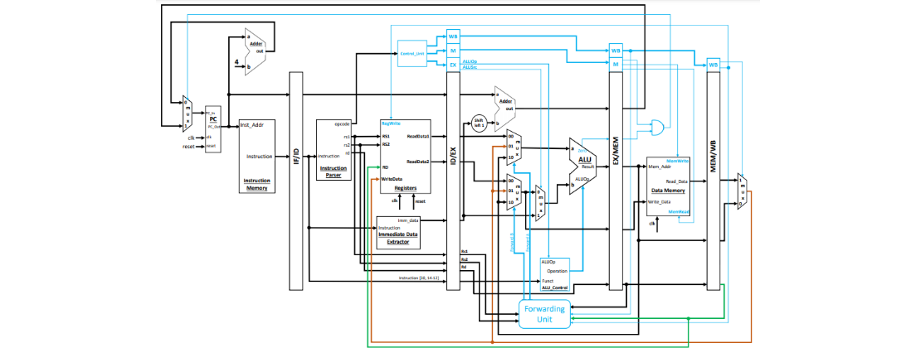
System Architecture
Top-Level Datapath & Integrated Math/Cache Schematic
Modifications: EX Parallel Math Cluster & L1 Caches
Control Flow: Dual EX Forwarding & Multi-Cycle Stalls

Slide 5
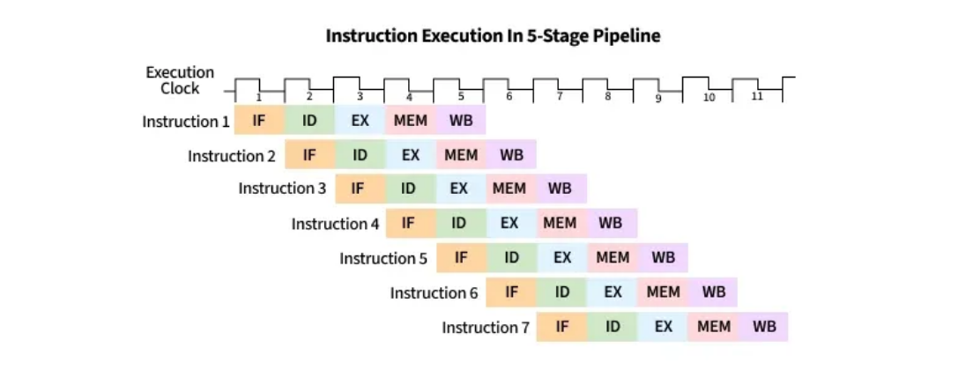
Pipeline Timing Trace
Real Benchmark Trace (31 Cycles): Stalls & Forwarding Interlocks
Sequence: LW Miss (10c Stall) → RAW Bypass to ADDI → BNE Taken (1c Flush) → FADD.S (5c) → FMUL.S (4c)

Slide 6
Implementation Roadmap
1
2
3
4
Base Datapath
Math Accelerators
L1 Cache Hierarchy
System Integration
RAW forwarding, stalls & branch flushes verified.
Hardware MUL, 32-cycle DIV & Single-Precision FPU.
2KB I/D Caches with 10-cycle burst refills.
RTL traces & FPGA hardware demo execution.

Slide 7


Verification Plan (1/3)
Core Execution & I-Cache Profiling
1. RISC-V Execution
2. HW Multiplier
3. L1 I-Cache
•
Load C binaries via Vivado.
•
Toggle DSP48E1 vs LUT logic.
•
Direct-mapped burst FSM timing.
•
Monitor hazard stall signals.
•
Measure clock cycle reduction.
•
Avoid 10-cycle memory fetch.
•
Verify 1-cycle EX forwarding.
•
Validate 1-cycle Booth execution.
•
Print UART hit latencies.

Slide 8
Verification Plan (2/3)
Floating Point, Divider & D-Cache Validation
5. HW Divider
4. IEEE 754 FPU
6. L1 D-Cache
•
32-cycle shift-subtract register.
•
Multi-cycle FSM state transitions.
•
Extract exact quotient & remainder.
•
4-word block spatial locality.
•
Prove 5c/4c/15c FPU latencies.
•
Track read/write buffer asserts.
•
UART hex vs Python script.
•
Assert 100% bit-accurate modulo.
•
Demonstrate 75% target hit-rate.

Slide 9

Verification Plan (3/3)
Branch Prediction, Counters & Bit-Manipulation
8. Performance CSRs
9. Zbb Extension
7. Branch Prediction
•
Dedicated PopCount ALU hardware.
•
64-bit hardware counter logic.
•
32-entry BTB state mapping.
•
Memory-mapped passive register reads.
•
Count 1-cycle pipeline flushes.
•
Benchmark against standard logic.
•
Zero-flush stable loop execution.
•
Calculate live Instructions/Cycle (IPC).
•
Measure total execution cycle drop.

Slide 10
Project Timeline & Milestones
PHASE 1 | OCT 25
PHASE 2 | NOV 1
Minimum Core
Full RV32IMF
PHASE 3 | NOV 8
FPGA Demo
•
Base 5-stage datapath & forwarding.
•
L1 D-Cache with byte masking.
•
Complete IEEE 754 FPU integration.
•
50 MHz Artix-7 timing closure.
•
Integrated EX stage multipliers.
•
64-bit CSR counters activated.
•
1.0 IPC Vivado simulation verified.
•
Passing compiled C suite in xsim.
•
Live Nexys A7 hardware demo.

Slide 11
Team Responsibilities
Team Member | Subsystem Role | Key Hardware Deliverables
Pisini Ramana | IF/ID Pipeline & I-Cache | 2KB I-Cache, 10-cycle burst refill FSM.
Chimbili Sahithi | EX/MEM & Hardware Divider | Byte-enable masking, 32-cycle Radix-2 divider.
Siddharth Misro | Hardware Multiplier & FPU | DSP48E1 multipliers, Newton-Raphson FDIV.
Bandaru Rohith Datta | Control Unit & D-Cache | 2KB D-Cache, Write buffer, CSR counters.
S. Praneeth Sai Bharath | Hazard Unit & FPGA Demo | Forwarding muxes, 32-entry BTB, C testbench.

Slide 12
Engineering Challenges & Mitigation
Multi-Cycle Stall Interlocking
50 MHz Timing Closure
Coordinate simultaneous requests from 32c DIV and 10c caches without deadlock.
Achieve positive timing slack (>10ns DSP path delay resolved via 20ns period).
Arithmetic Edge Cases
Speculative Branch Flush
Hardware handling of INT_MIN overflow, IEEE 754 NaN, and division-by-zero.
Clean 1-cycle misprediction invalidation without memory corruption.

Slide 13
END OF PRESENTATION
Questions & Discussion
Appendix notes covering microarchitecture details and cycle-by-cycle breakdowns are available for reference.

Slide 14

Image Sources
https://user-images.githubusercontent.com/56905673/117547053-f932fe00-b046-11eb-91af-9291291d4f52.png
Source: github.com
https://media.geeksforgeeks.org/wp-content/uploads/20250502142202506624/instruction_execution_in_5_stage_pipeline.webp
Source: www.geeksforgeeks.org

